Slide 1
Simplifying
Your Approach to Precision Oncology
Visit FindTheFusions.com to download this presentation.

Slide 2
The Importance of a
Precision Oncology Approach

Slide 3

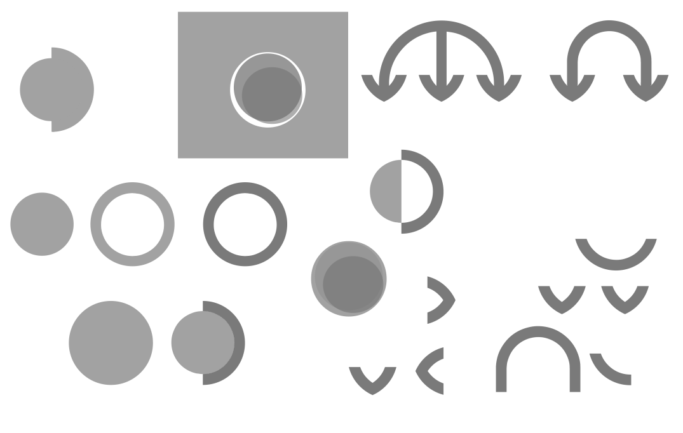
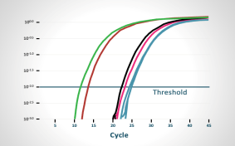
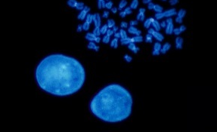
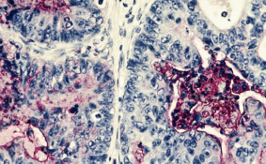


Cancer Is Driven by Genomic Alterations¹
Personalized Cancer Therapy
Historically, cancer has been defined
by its site of origin²
Today, certain cancers are increasingly
being defined by genomic alterations
(eg, point mutations, gene fusions)
capable of driving proliferation¹⁻³
MOLECULAR PROFILING
Precision oncology
RT-PCR
FISH
IHC
NGS
defines cancers by their
UNDERLYING GENOMIC CHANGES^{2,4}
FISH, fluorescence in situ hybridization; IHC, immunohistochemistry; NGS, next-generation sequencing; RT-PCR, reverse transcription-polymerase chain reaction.
1. Zhang R et al. Front Oncol. 2021;10:544579. doi:10.3389/fonc.2020.544579 2. Adashek JJ et al. Trends Cancer. 2021;7(1):15-28. doi:10.1016/j.trecan.2020.08.009 3. Zhang B et al. Medicine (Baltimore). 2022;10(43):e31380. doi:10.1097/MD.0000000000031380
4. Malone ER et al. Genome Med. 2020;12:8. doi:10.1186/s13073-019-0703-1

Slide 4



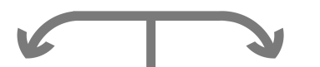

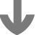

Precision Oncology Focuses on a Tumor’s
Specific Genomic Profile^{1,2}
Precision oncology aims to optimize
and tailor each patient’s treatment
approach based on the genomic
profile of the patient’s cancer³
  Genomic profiles can⁴
  Assist in optimal patient selection
  Inform treatment decision making
Precision Treatment Approach
TARGETED THERAPY
1. Adashek JJ et al. Trends Cancer. 2021;7(1):15-28. doi:10.1016/j.trecan.2020.08.009 2. Malone ER et al. Genome Med. 2020;12:8. doi:10.1186/s13073-019-0703-1 3. Rodriguez-Rodriguez L et al. In: Rodriguez-Rodriguez L, ed. Rutgers University Press; 2019;ix.
4. El Deiry WS et al. CA Cancer J Clin. 2019;69(4):305-343. doi:10.3322/caac.21560

Slide 5
Number of Actionable Genomic Alterations Continues to Rise
Individual genomic alterations may be rare; however, alterations in totality are found in a significant percentage of patients with cancer^{1,3-6}
  A genomic alteration is defined as actionable when there is
  a potential therapeutic target that will mitigate oncogenic consequences of the disrupted pathway⁷
  Genomic alterations may be treated directly with a targeted agent, or the aberrant pathogenic pathway caused by the genetic defect may be treated instead
>50 oncology drugs with genomic indications were approved between 2006 and 2020⁸
It is estimated that
>50%
of patients may have
a potential actionable
alteration^{1-3,a}
ªLarge retrospective series have documented that 80% to 90% of patients tested will have potentially actionable genomic alterations, although the definition of actionable can vary substantially.¹
1. Schwartzberg L et al. Am Soc Clin Oncol Educ Book. 2017;37:160-169. doi:10.1200/EDBK_174176 2. Kris MG et al. JAMA. 2014;311(19):1998-2006. doi:10.1001/jama.2014.3741 3. Priestley P et al. Nature. 2019;575(7781):210-216. doi:10.1038/s41586-019-1689-y
4. Tuxen IV et al. Clin Cancer Res. 2019;25(4):1239-1247. doi:10.1158/1078-0432.CCR-18-1780 5. Bertucci F et al. Genome Med. 2021;13(1):87. doi:10.1186/s13073-021-00897-9 6. Cobain EF et al. JAMA Oncol. 2021;7(4):525-533. doi:10.1001/jamaoncol.2020.7987
7. Yates LR et al. Ann Oncol. 2018;29(1):30-35. doi:10.1093/annonc/mdx707 8. Haslam A et al. Eur J Cancer. 2022;160:175-179. doi:10.1016/j.ejca.2021.10.028
Notes:
Thus, when we test and find a genomic alteration, we may be able to treat that alteration directly with a targeted therapy, or we may be able to treat the disease-causing biological pathway that is resulting from the alteration that we detected in our test.¹
Reference:
1. Yates LR, Seoane J, Le Tourneau C, et al. The European Society for Medical Oncology (ESMO) precision medicine glossary. Ann Oncol. 2018;29(1):30-35. doi:10.1093/annonc/mdx707

Slide 6

Data Establishing the Role of Clinically Actionable Genomic Markers Are Increasing¹
NTRK²
RET⁸
NRG1^{12,13}
METex14¹¹
Actionable genomic alterations are increasing in both quantity and rate of discovery¹
PIK3CA⁶
FGFR⁷
MSI-H/
dMMR⁵
MET^{9,10}
ALK³
ROS1⁴
BRAF²
KRAS²
EGFR²
BCR-ABL²
HER2²
1998
1999
2000
2001
2002
2003
2004
2005
2006
2007
2008
2009
2010
2011
2012
2013
2014
2015
2016
2017
2018
2019
2020
2021
ALK, anaplastic lymphoma kinase; BCR-ABL, breakpoint cluster region-Abelson murine leukemia homolog 1; BRAF, rapidly accelerated fibrosarcoma B1; EGFR, epidermal growth factor receptor; FGFR, fibroblast growth factor receptor; HER2, human epidermal
growth factor receptor 2; KRAS, Kirsten rat sarcoma; MET, mesenchymal-epithelial transition; METex14, mesenchymal-epithelial transition exon 14 skipping; MSI-H/dMMR, microsatellite instability-high/mismatch repair deficiency; NRG1, neuregulin 1;
NTRK, neurotrophic tyrosine receptor kinase; PIK3CA, phosphatidylinositol-4, 5-bisphosphate 3-kinase catalytic subunit alpha; RET, rearranged during transfection; ROS1, repressor of silencing 1.
1. Malone ER et al. Genome Med. 2020;12:8. doi:10.1186/s13073-019-0703-1 2. Colomer R et al. EClinicalMedicine. 2020;25:100487. doi:10.1016/j.eclinm.2020.100487 3. Kazandjian D et al. Oncologist. 2014;19(10):e5-e11. doi:10.1634/theoncologist.2014-0241
4. Kazandjian D et al. Oncologist. 2016;21(8):974-980. doi:10.1634/theoncologist.2016-0101 5. Marcus L et al. Clin Cancer Res. 2019;25(13):3753-3758. doi:10.1158/1078-0432.CCR-18-4070 6. Narayan P et al. Clin Cancer Res. 2021;27(7):1842-1849. doi:10.1158/
1078-0432.CCR-20-3652 7. Sayegh N et al. Onco Targets Ther. 2022;15:1047-1055. doi:10.2147/OTT.S318332 8. Bradford D et al. Clin Cancer Res. 2021;27(8):2130-2135. doi:10.1158/1078-0432.CCR-20-3558 9. MET. Accessed April 24, 2023. https://www.mycancergenome.org/content/gene/met/ 10. Recondo G et al. Cancer Discov. 2020;10(7):922-934. doi:10.1158/2159-8290.CD-19-1446 11. Desai A, Cuellar S. J Adv Pract Oncol. 2022;13(5):539-544. doi:10.6004/jadpro.2022.13.5.8
12. Schram AM et al. Cancer Discov. 2022;12(5):1233-1247. doi:10.1158/2159-8290.CD-21-1119 13. Geuijen CAW et al. Cancer Cell. 2018;33(5):922-936. doi:10.1016/j.ccell.2018.04.003
Notes:
Malone/ 2020/p1/col1/
para1/ln1-9
Malone/ 2020/p1/col1/
para1/ln1-5

Slide 7
Genomic Profile-Guided Treatment Decisions
Are the Future of Precision Oncology
Understanding a patient’s genomic profile and their oncogenic drivers can guide physicians toward a more tailored treatment approach^{1,2}
Knowledge of a patient's genomic profile can also eliminate inappropriate or less effective treatment choices³
1. El-Deiry WS et al. CA Cancer J Clin. 2019;69(4):305-343. doi:10.3322/caac.21560 2. Faulkner E et al. Value Health. 2020;23(5):529-539. doi:10.1016/j.jval.2019.11.010 3. Thomas DM et al. Public Health Genomics. 2022;25:70-79. doi:10.1159/000520000
Notes:
Thomas 2021/p73/c1/para2

Slide 8
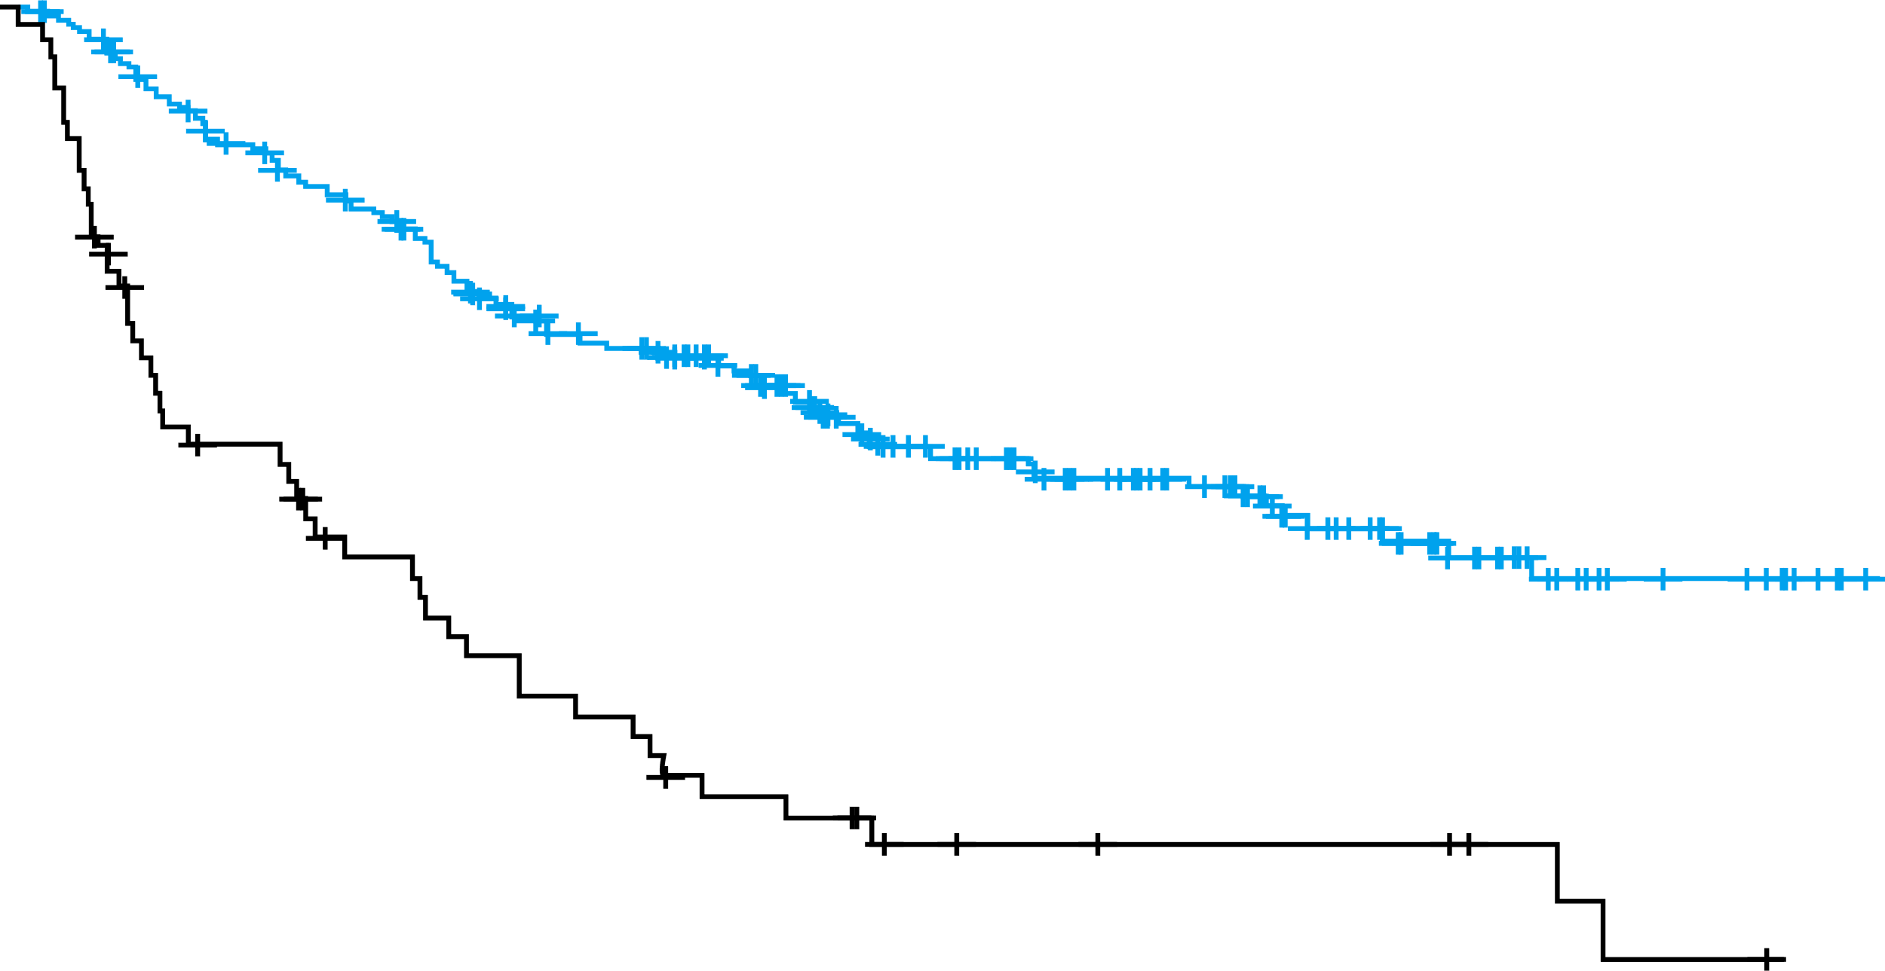
Targeting Genomic Alterations Can Lead to Better Outcomes for Patients^{1,2}
Knowledge of a tumor’s genomic profile may substantially impact disease management decisions and patient outcomes^{1,2}
OS Based on Availability of Molecular Test Results Before 1L Therapy (mNSq NSCLC)^{1,}*
OS in Pancreatic Cancer With Matched vs Unmatched Therapy³
1.00
HR=0.33 (95% CI, 0.237-0.469); P<.0001
Log-rank
P < .001
100
Matched therapy group vs unmatched therapy group
HR=0.42 (95% CI, 0.26-0.68); P=.0004
Available testing group N=261
Unavailable testing group N=65
0.75
80
60
Probability of OS
OS, %
0.50
40
0.25
20
Matched
Unmatched
No marker
0
0
0
6
12
18
24
30
36
0
0.5
1.0
1.5
2.0
2.5
3.0
3.5
4.0
4.5
5.0
Time, mo
Time since diagnosis of advanced disease, y
In both studies, OS was improved in patients who received therapies directed toward their specific alterations.^{1,3}
1L, first-line; HR, hazard ratio; mNSq, metastatic non-squamous; NSCLC, non–small cell lung cancer; OS, overall survival.
*Retrospective data collected between January 1, 2019 and December 31, 2020.
1. Aggarwal C et al. JCO Precis Oncol. 2023;7:e2300191. doi:10.1200/PO.23.00191 2. Zhao S et al. BMC Med. 2021;19:223. doi:10.1186/s12916-021-02089-z 3. Pishvaian MJ et al. Lancet Oncol. 2020;21(4):508-518. doi:10.1016/S1470-2045(20)30074-7
Notes:
Aggarwal/ 2023/p6/col1/para2/ln2-3/col2/para1/ln1-2
Pishvaian/ 2020/p6/
para4/ln3-6, p7/para1/
ln4-9.
Pishvaian/ 2020/p14/
Figure 2
Aggarwal/2023/p6/col2/para2/ln2-7
Zhao/ 2021/p8/col2/para3/ln1-5
Aggarwal/2023/p6/figure 1/Table 2
Aggarwal/2023/p6/col1/para2/ln2-3/col2/para1/ln1-2
Zhao/ 2021/p8/
col1/para3
/ln1-2, col2/para1
/ln1-2
Aggarwal/2023/p2/col2/ln1-7

Slide 9
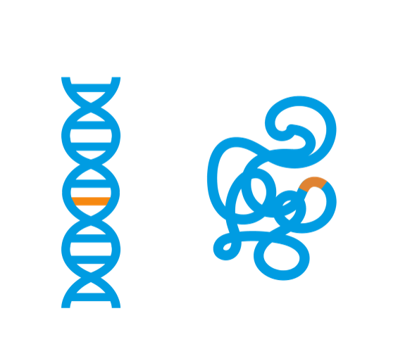




There Are Different Types of Genomic
Alterations That Drive Cancer
Common types of genomic alterations include point mutations and pathogenic gene fusions¹
Point mutations are changes in DNA base pairs²
  Examples include BRAF and EGFR³
Pathogenic gene fusions typically occur when
2 different genes join to form an abnormal
hybrid gene⁴
  Examples include ALK, NTRK, ROS1, and NRG1^{3,5}
  Genes involved in fusions are not located next to one another but are from separate chromosomal loci⁶
  Gene fusions can be comprised of multiple
  fusion partners⁷
Point Mutation
Oncogenic protein
Cancer
Gene Fusion
Oncogenic fusion protein
Cancer
1. Zhang R et al. Front Oncol. 2021;10:544579. doi:10.3389/fonc.2020.544579 2. Gunter C. Updated December 8, 2022. Accessed April 24, 2023. https://www.genome.gov/genetics-glossary/Point-Mutation 3. Malone ER et al. Genome Med. 2020;12:8.
doi:10.1186/s13073-019-0703-1 4. Latysheva NS, Babu MM. Nucleic Acids Res. 2016;44(10):4487-4503. doi:10.1093/nar/gkw282 5. Drilon A et al. J Clin Oncol. 2021;39(25):2791-2802. doi:10.1200/JCO.20.03307 6. Barr FG. Expert Rev Mol Diagn. 2016;16(9):921-923. doi:10.1080/14737159.2016.1220835 7. Stangl C et al. Nat Commun. 2020;11(1):2861. doi:10.1038/s41467-020-16641-7
Notes:
Barr/2016/p1/col1/para1/ln8
Stangl/2020/p2/col1/ln7-11
Zhang/ 2021/p1/
para2/ln1-2
Gunter/ 2022/p1/
para1/ln1-2
Malone/ 2020/p2/
table1/row5, row11
Latysheva/ 2016/p4488/figure1/all
Malone/ 2020/p2/
table1
Drilon/ 2021/p2791/col2/para2/ln1-2

Slide 10
Pathogenic Gene Fusions Can Be Strong Oncogenic Drivers^{1,2}
In an analysis of 79 patients with identified gene fusions, poorer outcomes
were observed in patients with pathogenic gene fusions who were not
matched to an FDA-approved fusion-targeted therapy²
11.6ª
PFS Outcomes for Treatments Matched
to Gene Fusions
vs Other Targets²
5.0
4.0
Treatment matched to fusions
(n=25)
Treatment matched to other alterations
(n=11)^{b}
Unmatched treatment
(n=42)
PFS, progression-free survival.
ªComparison of patients matched to fusions vs those unmatched to fusions, including unmatched to other alterations or unmatched, was significant by log-rank test (P=.034).²
^{b}Twelve of the 79 patients received treatment matched to other alterations, but one patient in the matched group had an unclear match and was excluded from the pair-wise comparison analysis.²
1. Gao Q et al. Cell Rep. 2018;23(1):227-238. doi:10.1016/j.celrep.2018.03.050 2. Nikanjam M et al. Cancer. 2020;126(6):1315-1321. doi:10.1002/cncr.32649

Slide 11
NRG1
An Example of an Important
Pathogenic Gene Fusion

Slide 12
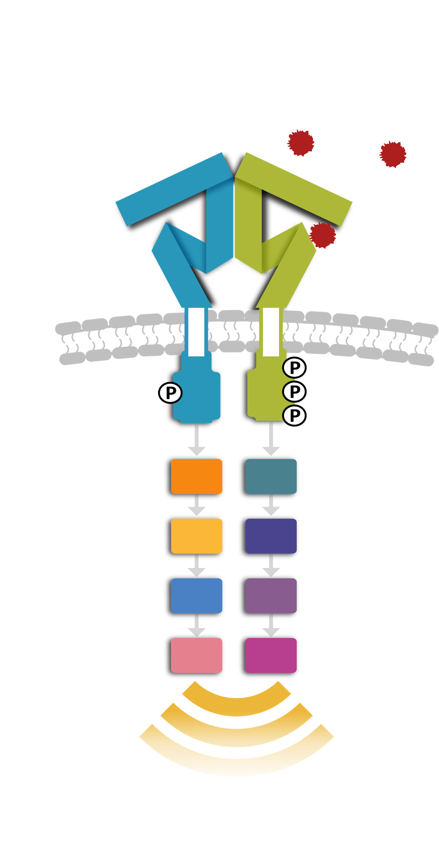

NRG1 Is Important for Normal Cellular Development^{1,2}
NRG1 is a key signaling protein involved in proliferation and survival^{1,2}
NRG1 normally is inactive until it is cleaved by proteases at the cell surface³
Extracellular binding of NRG1 induces receptor dimerization and activation of PI3K- and RAS-mediated growth pathways^{3,4}
Wild Type NRG1 Formation and Signaling
(WT) Pro-NRG1 cleavage
to active NRG1
WT NRG1 unbound
(extracellular)
WT NRG1-HER3 binding and receptor dimerization
NRG1
HER2
HER3
NRG1
Pro-NRG1
NRG1
HER2
HER3
Cleavage
RAS
PI3K
RAF
AKT
MEK
mTOR
MAPK
S6K
Normal cell signaling
Pro-NRG1 is cleaved to active NRG1, allowing it to bind to HER3 and promote receptor dimerization and signaling.³
HER3, human epidermal growth factor receptor 3; WT, wild type.
1. Mujoo K et al. Oncotarget. 2014;5(21):10222-10236. doi:10.18632/oncotarget.2655 2. Teo JCM et al. In: Lee SJ et al, eds. Academic Press; 2016:313-344. 3. Laskin J et al. Ann Oncol. 2020;31(12):1693-1703. doi:10.1016/j.annonc.2020.08.2335 4. Zhang C et al. Biochim Biophys Acta Rev Cancer. 2022;1877(3):188707. doi:10.1016/j.bbcan.2022.188707
Notes:
NRG1 signaling:
- NRG1 is an extracellular ligand that binds to HER receptors leading to the activation of downstream signaling pathways that cause cell growth (Rosas D, Raez LE, Russo A, Rolfo C. Neuregulin 1 gene (NRG1). A potentially new targetable alteration for the treatment of lung cancer. Cancers (Basel). 2021;13(20):5038. doi:10.3390/cancers13205038)
Mujoo/2014/p10222/col1/para1/ln14-16; col2/para1/ln1/p10222/col2/para2/ln8-9; p10223/col1/ln1-3; Teo/2016/p321/para2/ln1-3
Laskin/2020/p1694/col2/para1/ln1-5/p1697/fig1/ln2-3
Rosas/
2021/p2/para1/
ln8-9,fig1, p3/para5/ln1-7
Laskin/
2020/
p1693/
col1/para1/ln3-6,
Mujoo/2014/p10222/col1/para1/ln14-16;col2/para1/ln1;Teo/ 2016/p321/para2/ ln1-3
Laskin/ 2020/p1696/ fig1A; Zhang/2022/p2/col1/ln7-11/fig1
Laskin/ 2020/p1694/ col2/para1/ ln3-5, para2/ln1-5

Slide 13
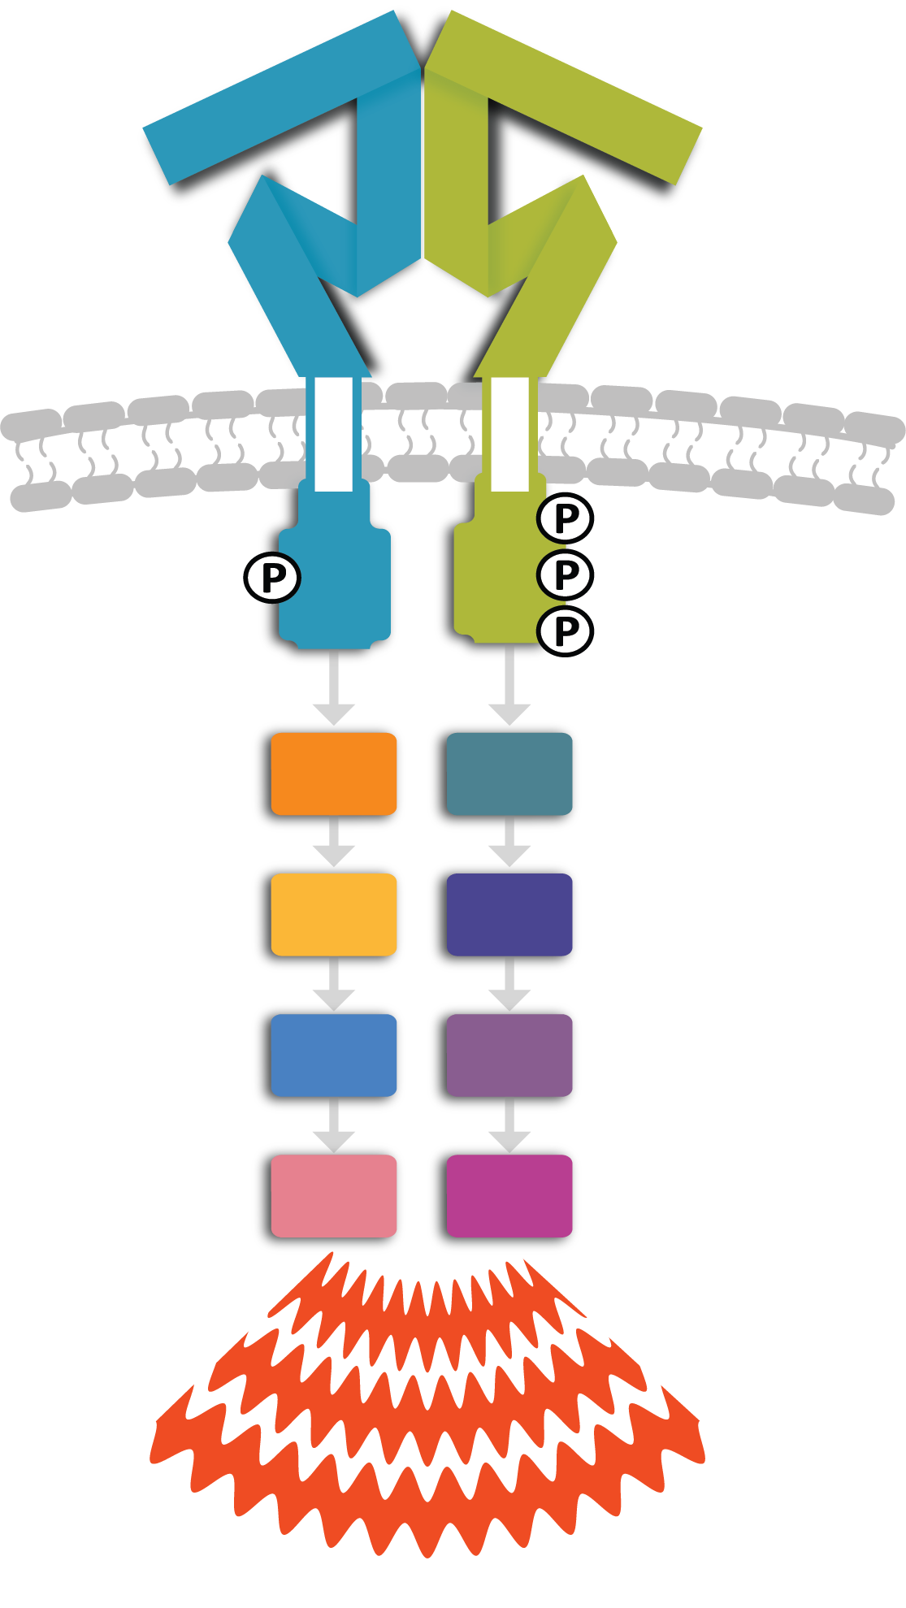


NRG1 Fusions Result in Increased Cell Signaling and Growth^{1,2}
NRG1 fusions induce receptor dimerization and result in aberrant cell signaling^{3,4}
NRG1 fusions
  Are heterogenous and have many different gene partners and breakpoints⁵
  Cannot be cleaved by cell surface proteases resulting in increased expression of the fusions at the cell surface³
  Retain the signaling domain of WT NRG1^{4,6}
  Certain NRG1 fusions are membrane bound resulting in increased cell signaling⁴
NRG1 Fusion Signaling
NRG1 fusion
NRG1 fusion binding
HER2
HER3
NRG1
Signaling
domain
is tethered
to membrane
cleavage
NRG1 fusion
RAS
PI3K
RAF
AKT
Fusion partner
MEK
mTOR
MAPK
S6K
Increased signaling
NRG1 fusions remain anchored in the cell membrane where they bind to and activate HER3, leading to dimerization with HER2 and downstream oncogenic signaling.⁴
1. Schram AM et al. Cancer Discov. 2022;12(5):1233-1247. doi:10.1158/2159-8290.CD-21-1119 2. Geuijen CAW et al. Cancer Cell. 2018;33(5):922-936. doi:10.1016/j.ccell.2018.04.003 3. Laskin J et al. Ann Oncol. 2020;31(12):1693-1703. doi:10.1016/j.annonc.2020.08.2335
4. Zhang C et al. Biochim Biophys Acta Rev Cancer. 2022;1877(3):188707. doi:10.1016/j.bbcan.2022.188707 5. Drilon A et al. J Clin Oncol. 2021;39(25):2791-2802. doi:10.1200/JCO.20.03307 6. Howarth KD et al. Breast Cancer Res. 2021;23(1):3.
doi:10.1186/s13058-020-01377-5
Notes:
Normal (wild-type) NRG1 binds HER3 leading to dimerization with HER2 and subsequent signaling. In NRG1 fusions, the NRG1 signaling domain (EGF domain) remains localized to HER3 and tethered in the cell membrane via its fusion partner resulting in heightened HER2-HER3 signaling.
Schram/2022/ p2/para3/ln3-5, 7-10, p9/para3/ln1-2; Geuijen/2018/p930/col1/para2/ln16-20; pE5/para1/ln4
Laskin/2020/p1694/col1/para3/ln1-10; Zhang/2022/p1/col2/para2/ln6-7
Drilon/2021/p2798/col1/para2/ln15-16; p2800/col2/para2/ln1-2
Laskin/2020/p1694/p3/ln1-3/p1697/fig1/ln4-5
Zhang/2022/p2/col1/para3/ln2-3; Howarth/2021/p2/col1/para2/ln1-5
Zhang/2022/p2/col1/para3/ln4-6
Zhang/2022/p2/col1/para3/ln4-5;fig1/ln1

Slide 14
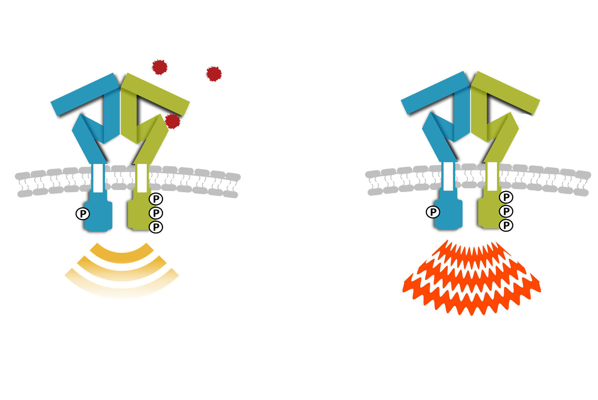

NRG1 Fusions Can Lead to
Uncontrolled Growth and Cancer^{1,2}
Cancers resulting from NRG1 gene fusions are reported to be aggressive and associated with poor outcomes³⁻⁷
NRG1 fusions can lead to
  Enhanced pathologic activation of PI3K- and RAS-mediated pathways^{6,8}
  Abnormal cell proliferation^{6,8}
NRG1+ tumors
  Have histologic features associated with growth, recurrence, invasiveness, metastasis, resistance to therapy, and worse prognosis³⁻⁷
  Respond poorly to available therapies and are associated with lower OS, DFS, and PFS in lung cancer^{4-7,9}
An example of WT NRG1 and NRG1 Fusion Signaling
WT NRG1 signaling
NRG1 fusion signaling
HER2
HER3
HER2
HER3
HER2
HER2
HER3
HER2
HER3
HER3
Signaling
domain
is tethered
to membrane
P
Normal cell growth
Uncontrolled cell growth and cancer
NRG1 fusions remain anchored in the cell membrane where they bind to and activate HER3, leading to dimerization with HER2 and downstream oncogenic signaling.⁸
DFS, disease-free survival; NRG1+, neuregulin 1 fusion positive.
1. Schram AM et al. Cancer Discov. 2022;12(5):1233-1247. doi:10.1158/2159-8290.CD-21-1119 2. Geuijen CAW et al. Cancer Cell. 2018;33(5):922-936. doi:10.1016/j.ccell.2018.04.003 3. Dhanasekaran SM et al. Nat Commun. 2014;5:5893. doi:10.1038/ncomms6893
4. Rosas D et al. Cancers (Basel). 2021;13(20):5038. doi:10.3390/cancers13205038 5. Drilon A et al. J Clin Oncol. 2021;39(25):2791-2802. doi:10.1200/JCO.20.03307 6. Laskin J et al. Ann Oncol. 2020;31(12):1693-1703. doi:10.1016/j.annonc.2020.08.2335 7. Shin DH et al. Oncotarget. 2016;7(43):69450-69465. doi:10.18632/oncotarget.11913 8. Zhang C et al. Biochim Biophys Acta Rev Cancer. 2022;1877(3):188707. doi:10.1016/j.bbcan.2022.188707 9. Jones MR et al. Clin Cancer Res. 2019;25(15):4674-4681.
doi:10.1158/1078-0432.CCR-19-0191
Notes:
Normal (wild-type) NRG1 binds HER3 leading to dimerization with HER2 and subsequent signaling. In NRG1 fusions, the NRG1 signaling domain (EGF domain) remains localized to HER3 and tethered in the cell membrane via its fusion partner resulting in heightened HER2-HER3 signaling.
Schram/2022/ p2/para3/ln3-5, 7-10,
p9/para3/ln1-2; Geuijen 2018/p930/col1/para2/ln16-20;
pE5/para1/ln4
Dhanasekaran 2014/p11/para1/ln3-5
Rosas 2021/p4/para3/ln28-31, p5/para2/ln7-11; Drilon 2021/
p2800/c1/para2/ln1-6; Laskin 2020/
p1698 [pdf p6]/c2/para1/ln1-4
Shin 2016/p69457/c1/para2/ln2-11
Laskin/2020/ p1694/col1/para3/ln1-10/p1697/fig1/ln8-9; Zhang/2022/p2/col/para3/ln8-9/col2/ln1-2
Drilon/2021/p2791/col1/para1/ln1-2, col2/para2/ln1-2, p2800/col1/para2/ ln1-6; Dhanasekaran/ 2014/p11/para1/ ln3-5; Laskin/2020/p1698 /col2/para1/ln1-4; Rosas/2021/p4/ para3/ln28-31, p5/para2/ln7-11; Shin/2016/p69452/col2/para2/all, p69453/col2/para1/lln1-2,4-6, p69454/fig2, p69455/col1/para1/ln1-3, fig3, p69456/fig4, p69460/col2/para3/
lln3-6;
Rosas/2021/p5/§4/ln19-20; Drilon/2021/p2796/col1/para4/ln9-14, para5/ln1-14, col2/para1/ln4-5,8-11, para2/ln1-4,7-9, para4/ln1-13, p2798/table2, col2/para2/all, para3/all, p2800/col1/para2/ln1-6, col2/para2/ln5-9; Laskin/2020/p1698/col2/para2/ln1-6; Shin/2016/p69457/col1/para2/all; Jones/2019/p4675/col1/para1/ln14-16, p4678/col2/para2/all, p4679/col1/para1/ln1, col2/para3/all; p4680/col1/para1/all
Zhang/2022/p2/col1/para3/ln4-5;fig1/ln1

Slide 15

NRG1 Gene Fusions Can Occur in Many Types of Solid Tumors¹
NRG1 Fusion Frequency Estimatesª
Enrichment is observed in some tumors, particularly^{2,6}
  Invasive mucinous lung adenocarcinoma
  NSCLC that is negative for other
  driver mutations
  KRAS wild-type pancreatic cancer
NRG1 fusions generally occur in the
absence of other driver mutations⁶
 | Overall | Enrichment
 | Lung cancer (0.3%-1.7%)^{1,2} | Invasive mucinous lung adenocarcinoma (27%-31%)³
 | Pancreatic cancer (0.5%-1.8%)^{2,4} | KRAS wild-type pancreatic cancer (up to 6%)⁵
 | Other (<1%, eg, breast, cholangiocarcinoma, colorectal cancers)²
ªThe frequency of NRG1 tumors is still under investigation and can vary significantly based on testing methodology.²
1. Drilon A et al. Cancer Discov. 2018;8(6):686-695. doi:10.1158/2159-8290.CD-17-1004 2. Jonna S et al. Clin Cancer Res. 2019;25(16):4966-4972. doi:10.1158/1078-0432.CCR-19-0160 3. Laskin J et al. Ann Oncol. 2020;31(12):1693-1703. doi:10.1016/j.annonc.2020.08.2335
4. Knepper TC et al. J Clin Oncol. 2022;40(suppl 16):4155. doi:10.1200/JCO.2022.40.16_suppl.4155 5. Jones MR et al. Clin Cancer Res. 2019;25(15):4674-4681. doi:10.1158/1078-0432.CCR-19-0191 6. Drilon A et al. J Clin Oncol. 2021;39(25):2791-2802. doi:10.1200/JCO.20.03307

Slide 16
NRG1+ Tumors Can Be Aggressive and Respond
Poorly to Existing Standard of Care^{1,2}
In a retrospective global registry study of 110 patients, NRG1+ NSCLC was associated with limited response to available therapies³
Activity of Systemic Therapy in NRG1+ NSCLC^{3,}*
 | ORR, % | Median PFS, mo (95% CI)
Platinum-doublet chemotherapy (n=15) | 13 | 5.8 (2.2-9.8)
Taxane-based chemotherapy (n=7) | 14 | 4.0 (0.8-5.3)
Combination chemotherapy and immunotherapy (n=9) | 0 | 3.3 (1.4-6.3)
Single-agent immunotherapy (n=5) | 20 | 3.6 (0.9-undefined)
Targeted therapy with kinase inhibitor (n=20) | 25 | 2.8 (1.9-4.3)
ORR, overall response rate.
*Patients either diagnosed with or who developed metastatic disease during the course of their disease.
1. Rosas D et al. Cancers (Basel). 2021;13(20):5038. doi:10.3390/cancers13205038 2. National Institutes of Health, National Cancer Institute. Accessed April 24, 2023. https://www.cancer.gov/types/lung/patient/non-small-cell-lung-treatment-pdq 3. Drilon A et al.
J Clin Oncol. 2021;39(25):2791-2802. doi:10.1200/JCO.20.03307
Notes:
Do you consider the possibility of pathogenic gene fusions in your patients who fail to respond to standard of care?
Rosas/2021/
p5/para2/
lln7-11;
NIH-NSCLC/ 2022p28/TreatmentOptionOverview/
Keypoints/ bullet2,6-7
Drilon/2021/ p2793/col1/ para4/ln1-3, p2798/col2/ para2/ln4-8; para3/ln1-3;
p2800/col1/
para2/ln1-6
Drilon/ 2021/
p2798/
Table2/all
Drilon/2021/ p2796/col1/para4/ln1-4

Slide 17
Testing With Both DNA and RNA (RNA-Based NGS)
Is the Key to Finding
Actionable Alterations

Slide 18
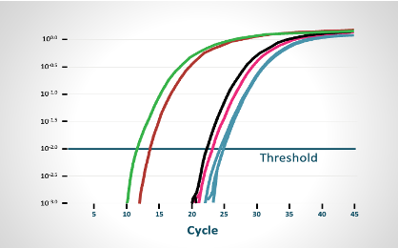
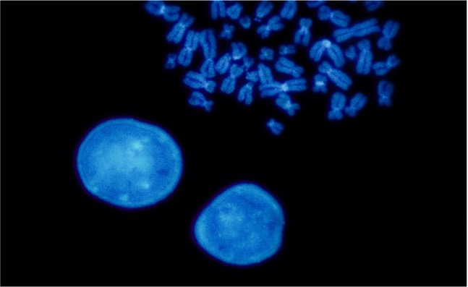
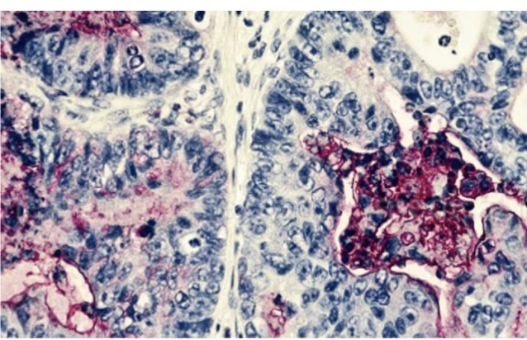
Classical Biomarker Screening Methods Were Developed to Detect Single Molecular Targets^{1,2}
Conventional test methods limit the ability to detect many pathogenic gene fusions.
RT-PCR
FISH
IHC
Limitations include
Inability to identify the full breadth of genomic alterations³
Limited ability to identify full breadth of fusion partners and breakpoints¹
  May require a significant amount of tissue and can exhaust tissue samples⁴
1. Su D et al. J Exp Clin Cancer Res. 2017;36(1):121. doi:10.1186/s13046-017-0591-4 2. Bruno R, Fontanini G. Diagnostics (Basel). 2020;10(8):521. doi:10.3390/diagnostics10080521 3. Personalized Medicine in Oncology. Accessed April 24, 2023. https://www.personalizedmedonc.com/article/next-generation-sequencing-testing-in-oncology/ 4. Yu TM et al. Clin Lung Cancer. 2018;20(1):20-29. doi:10.1016/j.cllc.2018.08.010
Notes:
Su/2017/p2/ col1/para2 /ln6-9, Bruno 2020/p2/para5/ln3-4, p3/para1/
ln8-13
NGS testing in oncology/2022/p7/para2/
ln1-6
Su/2017/
p2/col1/para2/ln18-19.
Yu/2018/p28/ col2/para4/
ln2-7.

Slide 19
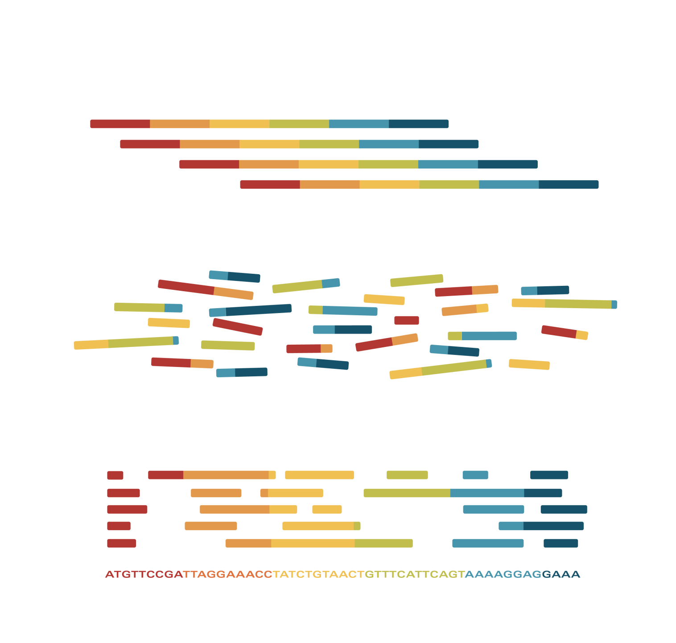
NGS Can Detect a Broad Range of Genomic Alterations¹
NGS has emerged as a key tool in
profiling many solid tumors²
NGS Process
NGS is a high-throughput genomic sequencing technology that allows for the simultaneous analysis of numerous alterations that²
  Can be performed with DNA or RNA³
  Has several advantages over current conventional methods in detecting pathogenic gene fusions³
Nucleic acid extraction and isolation
RNA NGS
Fragmentation and library creation
There are clear
differences between
DNA- and RNA-based NGS³
Amplifying and sequencing the libraries
1. Singh RR. J Mol Diagn. 2020;22(8):994-1007. doi:10.1016/j.jmoldx.2020.04.213 2. Goswami RS et al. Am J Clin Pathol. 2016;145(2):222-237. doi:10.1093/ajcp/aqv023 3. Bruno R, Fontanini G. Diagnostics (Basel). 2020;10(8):521. doi:10.3390/diagnostics10080521

Slide 20
DNA-Based NGS Alone Can Miss
Pathogenic Gene Fusions¹
DNA-based sequencing can lead to
false-negative and false-positive results
in a variety of cases, particularly in the
detection of gene fusions^{1,2}
Commercially available NGS for liquid biopsies relies on analysis of circulating cfDNA and lacks the sensitivity of RNA-based NGS³
True-positive
fusion eventsª
RNA-based NGS
DNA-based NGS^{b}
RNA-based NGS
is recommended to capture
what DNA-based NGS can miss¹
Gene fusions detected by DNA-based NGS only
cfDNA, cell-free DNA.
ª Graphic for illustrative purposes only. Not drawn to scale or reflective of actual results captured by the different methodologies.
^{B}DNA-based NGS can detect some fusions not found by certain RNA-based NGS.²
1. Benayed R et al. Clin Cancer Res. 2019;25(15):4712-4722. doi:10.1158/1078-0432.CCR-19-0225 2. Heydt C et al. BMC Med Genomics. 2021;14:62. doi:10.1186/s12920-021-00909-y 3. Choudhury Y et al. Poster presented at: 2022 ASCO Annual Meeting;
June 3-7, 2022; Chicago, IL.
Notes:
Heydt 2021/p7/figure2/all

Slide 21

RNA-Based NGS Is More Sensitive Than DNA-Based NGS Alone for Detecting Pathogenic Gene Fusions¹
RNA-based NGS can detect genomic alterations missed by DNA-based NGS^{1,2}
RNA-based NGS detects gene expression and many structural variants³
  RNA-based NGS is inclusive of both DNA and RNA sequencing
RNA-based NGS reduces the technical challenges that occur with DNA-based NGS when sequencing long introns³
RNA-based NGS can improve the detection rate of
DNA-based NGS alone and provide more sensitive
detection results^{1,4,5}
DNA-Based vs RNA-Based NGS for Fusions⁶
Large introns
DNA
RNA
(Excessive sequencing)
Repetitive introns
DNA
RNA
(Cannot align reads)
DNA
RNA
(Below assay sensitivity)
~
NRG1 fusions are
more likely to be missed
Low tumor sample
(If highly expressed)
unless testing with RNA-based NGS²
DNA
Complex genomic events
RNA
(Cannot capture)
1. Benayed R et al. Clin Cancer Res. 2019;25(15):4712-4722. doi:10.1158/1078-0432.CCR-19-0225 2. Drilon A et al. J Clin Oncol. 2021;39(25):2791-2802. doi:10.1200/JCO.20.03307 3. Mahmoud M et al. Genome Biol. 2019;20(1):246. doi:10.1186/s13059-019-1828-7
4. El-Deiry WS et al. CA Cancer J Clin. 2019;69(4):305-343. doi:10.3322/caac.21560 5. Hindi I et al. Exp Mol Pathol. 2020;114:104403. doi:10.1016/j.yexmp.2020.104403 6. Davies KD, Aisner DL. Clin Cancer Res. 2019;25(15):4586-4588. doi:10.1158/1078-0432.CCR-19-1361

Slide 22
Ordering RNA-Based NGS Is a Key to Obtaining
Comprehensive Results^{1,2}
Commercial vendors are increasing
their NGS testing options​¹
However, not all vendors offer
combined RNA + DNA NGS
Clinicians need to stay up to date on
testing modalities to achieve the most comprehensive testing results¹
Test Name; Vendor | Analyteª | Genes on Panel
Altera™³; Natera | DNA/RNA | 440
Caris®⁴: Caris Life Sciences | DNA/RNA | WES/WTS
Neo Comprehensive™⁵; NeoGenomics Laboratories | DNA/RNA | 517
OncoExTra™⁶; Exact Sciences | DNA/RNA | WES/WTS
Oncomine™ Dx⁷; Thermo Fisher Scientific | DNA/RNA | 23
OmniSeq INSIGHT℠⁸; Labcorp Oncology | DNA/RNA | 523
StrataNGS™⁹; Strata Oncology | DNA/RNA | 437
Tempus xT¹⁰; Tempus | DNA/RNA | 648
FoundationOne® CDx¹¹; Foundation Medicine | DNA | 324
FoundationOne® Liquid CDx¹²; Foundation Medicine | cfDNA | 318
Guardant360® CDx^{13,14}; Guardant Health | cfDNA | 74
MSK-IMPACT®¹⁵; Memorial Sloan Kettering Cancer Center | DNA | 468
NeoGenomics NeoTYPE® Discovery¹⁶; NeoGenomics Laboratories | DNA | 336
Northstar Select™¹⁷; NorthstarOnc/BillionToOne | DNA | 84
Paradigm Dx PCDx™¹⁸; Paradigm Diagnostics | DNA | 234
PathGroup SmartGenomics™ Complete¹⁹; PathGroup | DNA | 160
WES, whole exome sequencing; WTS, whole transcriptome sequencing.
ª Tests in gray have a limited ability to identify a broad range of gene fusions.²
1. Park HJ et al. J Mol Diagn. 2021;23(11):1443-1451. doi:10.1016/j.jmoldx.2021.07.027 2. Benayed R et al. Clin Cancer Res. 2019;25(15):4712-4722. doi:10.1158/1078-0432.CCR-19-0225 3. Natera. Accessed April 24, 2023. https://www.natera.com/oncology/signatera-advanced-cancer-detection/clinicians/altera 4. Caris Life Sciences. Accessed April 24, 2023. https://www.carislifesciences.com/products-and-services/molecular-profiling/tissue-profiling/ 5. Neogenomic. Accessed April 24, 2023. https://neogenomics.com/test-menu/neo-comprehensive-solid-tumor 6. Exact Sciences. Accessed April 24, 2023. https://precisiononcology.exactsciences.com/healthcare-providers/therapy-selection/advanced-solid-tumors/oncomapextra?_ga=2.112104071.A2014766495.1671548515-1652124340.1671548515 7. ThermoFisher Scientific. Accessed April 24, 2023. https://assets.thermofisher.com/TFS-Assets/CSD/Flyers/odxtt-us-pathologists-flyer 8. OnmiSeq. Accessed April 24, 2023. https://www.omniseq.com/wp-content/uploads/2021/05/OmniSeq-INSIGHT-INTENDED-US-PERFORMANCE-SPECS 9. StrataNGS. Accessed April 24, 2023. https://static1.squarespace.com/
static/5eb03a8225db790ffcb446cf/t/61688603a2642a5336a46881/1634240003520/Gene_List_SO-SPEC-003v5.pdf 10. Tempus. Accessed April 24, 2023. https://www.tempus.com/oncology/genomic-profiling/ 11. Foundation Medicine. Accessed April 24, 2023. https://www.foundationmedicine.com/test/foundationone-cdx 12. Foundation Medicine, Accessed October 2, 2023. https://www.foundationmedicine.com/test/ foundationone-liquid-cdx 13. Guardant Health. Accessed April 24, 2023. https://guardant360cdx.com/ gene-list/ 14. US Food and Drug Administration. Accessed April 24, 2023. https://www.fda.gov/medical-devices/recently-approved-devices/guardant360-cdx-p200010s001 15. US Food and Drug Administration. Accessed April 24, 2023. https://www.fda.gov/news-events/press-announcements/fda-unveils-streamlined-path-authorization-tumor-profiling-tests-alongside-its-latest-product-action 16. NeoGenomics. Accessed April 24, 2023. https://neogenomics.com/sites/default/files/NeoGenomicsTestCatalog.pdf 17. Northstar Onc. Accessed Sept 14, 2023. https://northstaronc.com/wp-content/uploads/2023/07/BTO-Northstar-Select-Spec-Sheet-_072623.pdf 18. Paradigm. Accessed April 24, 2023. https://www.therapyselect.de/sites/default/files/downloads/pcdx/pcdx_tumor-profiling-menu_en.pdf
19. PathGroup. Accessed April 24, 2023. http://www.pathgroup.com/oncology/smartgenomics/
All trademarks are property of their respective owners.
Notes:
Speaker note: After presenting this slide: Question, comment for the audience:
Do you know what is included on your NGS platform? OR Ask your pathology department what is included on your NGS platform.
Altera/
p1/ln1; p2/
section1/ln1;p3
/para2/
ln2-3
NeoComprehensive/p1/para1/bullet 1
Northstar Select/p1/ln1-2

Slide 23
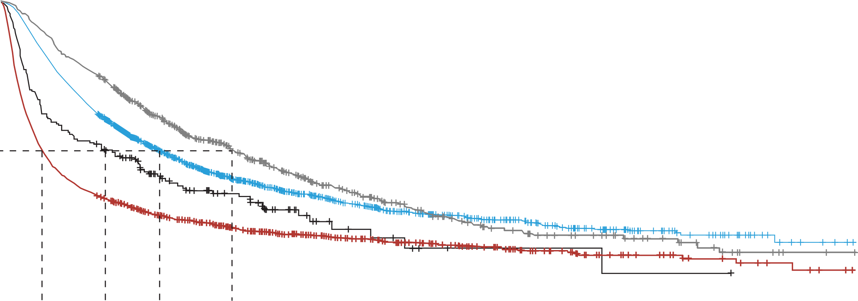
Comprehensive Genomic Profiling Is Associated With Improved OS in NSCLC Patients¹
rwOS From aNSCLC Diagnosis, by Testing Type and Receipt of Systemic Therapy¹
No. at risk at index | Testing/treatment group | Median, mo (95% CI)
1852 | Small panel with any systemic therapy | 15 (14-16)
1253 | Small panel and no systemic therapy | 4 (4-5)
603 | CGP with any systemic therapy | 22 (18-25)
176 | CGP and no systemic therapy | 10 (6-15)
1.00
Small panel only and any systemic treatment
Small panel only and no systemic treatment
CGP ever and any systemic treatment
CGP ever and no systemic treatment
0.75
Probability of rwOS
0.50
0.25
Predictors of rwOS by Testing Type (Cox proportional hazards model) | Testing/treatment group |  | Median, mo (95% CI)
 | Alive N=1186 | Deceased N=2698 | HR (95% CI)
CGP Testing, No. (%)
No | 906 (76%) | 2199 (82%) | 1.00
Yes | 280 (24%) | 499 (18%) | 0.80 (0.72-0.89)
0.00
0
3
6
9
12
15
18
21
24
27
30
33
36
39
42
45
48
51
54
57
60
63
66
69
72
75
78
Time, mo
Treated patients receiving CGP testing during follow-up had greater median rwOS (22 months vs 15 months)¹
aNSCLC, advanced non–small cell lung cancer; CGP, comprehensive genomic profiling; HR, hazard ratio; rwOS, real-world overall survival.
1. Simon G et al. Poster presented at: European Society for Medical Oncology; October 21, 2023; Madrid, Spain. Poster #1422P.
Notes:
Simon/2023/col3/Figure 4 all
Simon/2023/col3/Figure 4,5

Slide 24
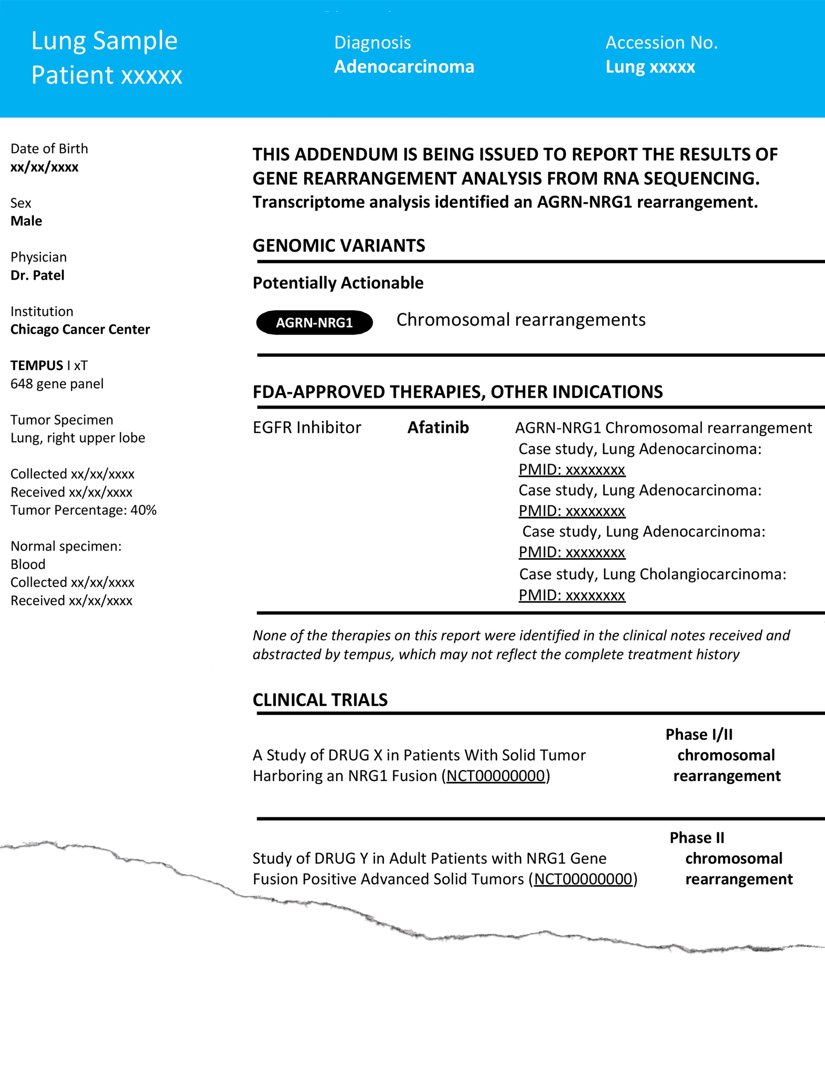
Most NGS Reports Highlight Actionable Information
Most reports will provide variant results listed by tier of evidence in order of relevance, and relevant FDA-approved therapies. Certain reports may identify possible clinical trial options.
Methodology
Test material: Tumor DNA/RNA¹
Gene panel: Tempus xT Targeted Panel of 648 genes. Assay v4—a custom oncology testing panel (see detailed list of genes in full report)^{2,3}
Instrument: Illumina Novaseq 6000¹
Reference genome: GRCh37 (hg19)³
Methodology identifies material tested (DNA and/or RNA)
Higher tumor cell content is associated with a lower probability
of false negatives.
Methodology details include test description, sequencing instrument, and reference
genome used.
1. National Library of Medicine. Updated September 1, 2022. Accessed April 24, 2023. https://www.ncbi.nlm.nih.gov/gtr/tests/558436/overview/ 2. Tempus. Accessed April 24, 2023. https://www.tempus.com/oncology/genomic-profiling/ 3. Tempus.
Accessed April 24, 2023. https://www.tempus.com/wp-content/uploads/2022/09/Tempus-Onco_Clinical-Report-Sample.pdf

Slide 25

RNA-Based NGS Is Important to Identify a Wide Range of Pathogenic Fusions, Including NRG1¹
The diversity of NRG1 fusion partners and breakpoints
and the large intronic regions of the NRG1 gene can
make detection more challenging^{1,2}
NRG1 fusions may be missed unless testing
accounts for these characteristics^{1,2}
Technologic and methodologic improvements,
such as RNA-based NGS, are reported to capture significantly more actionable fusions^{1,2}
1. Drilon A et al. J Clin Oncol. 2021;39(25):2791-2802. doi:10.1200/JCO.20.03307 2. Jonna S et al. Clin Cancer Res. 2019;25(16):4966-4972. doi:10.1158/1078-0432.CCR-19-0160

Slide 26

Collaboration Is Important to Help Identify
Actionable Information in NGS Reports
Maximizing the clinical use of NGS reports is best achieved through a multidisciplinary approach^{1,2}
Collaboration between key experts facilitates
the most informed decision-making^{2,3}
Oncologists
Pathologists
Pharmacists
Radiologists
Allied health professionals
Molecular tumor boards may provide key
learning opportunities for identifying
actionable genomic alterations^{1,2}
1. Perakis SO et al. ESMO Open. 2020;5(5):e000872. doi:10.1136/esmoopen-2020-000872 2. Malone ER et al. Genome Med. 2020;12:8. doi:10.1186/s13073-019-0703-1 3. Specchia ML et al. BMC Health Serv Res. 2020;20(1):73. doi:10.1186/s12913-020-4930-3

Slide 27
Summary

Slide 28
Key Takeaways
Precision oncology defines cancer according to its genomic profile rather than by the organ
or tissue of origin^{1,2}
  Pathogenic gene fusions are becoming increasingly actionable³
  Targeting these genomic alterations may lead to improved outcomes⁴
NRG1 is an important pathogenic gene fusion that can occur across tumor types and is reported to be associated with poor outcomes, including increased mortality and resistance to currently available therapies in lung cancer⁵⁻⁹
RNA-based NGS tests can improve identification of genomic alterations over DNA-based methods, including pathogenic gene fusions such as NRG1^{9,10}
Precision oncology benefits from collaboration between oncologists and pathologists to deliver appropriate genomic analysis that can lead to actionable results and potentially meaningful
outcomes for patients^{2,11}
1. Adashek JJ et al. Trends Cancer. 2021;7(1):15-28. doi:10.1016/j.trecan.2020.08.009 2. Malone ER et al. Genome Med. 2020;12:8. doi:10.1186/s13073-019-0703-1 3. Nikanjam M et al. Cancer. 2020;126(6):1315-1321. doi:10.1002/cncr.32649 4. Zhao S et al.
BMC Med. 2021;19(1):223. doi:10.1186/s12916-021-02089-z 5. Drilon A et al. Cancer Discov. 2018;8(6):686-695. doi:10.1158/2159-8290.CD-17-1004 6. Jonna S et al. Clin Cancer Res. 2019;25(16):4966-4972. doi:10.1158/1078-0432.CCR-19-0160 7. Rosas D et al.
Cancers (Basel). 2021;13(20):5038. doi:10.3390/cancers13205038 8. Shin DH et al. Oncotarget. 2016;7(43):69450-69465. doi:10.18632/oncotarget.11913 9. Drilon A et al. J Clin Oncol. 2021;39(25):2791-2802. doi:10.1200/JCO.20.03307 10. Benayed R et al.
Clin Cancer Res. 2019;25(15):4712-4722. doi:10.1158/1078-0432.CCR-19-0225 11. Perakis SO et al. ESMO Open. 2020;5(5):e000872. doi:10.1136/esmoopen-2020-000872

Slide 29
Thank you!
©2024 Merus N.V. All rights reserved.
MAT-0006 1/24

